Slide 1
Data Development Utilizing Database Design and SQL
Day 6
Notes:
1

Slide 2
Creating a New Table from an Existing Table
Can create new table using an existing table
Use CREATE TABLE command
Can add query results to table by placing SELECT command in an INSERT command

Slide 3
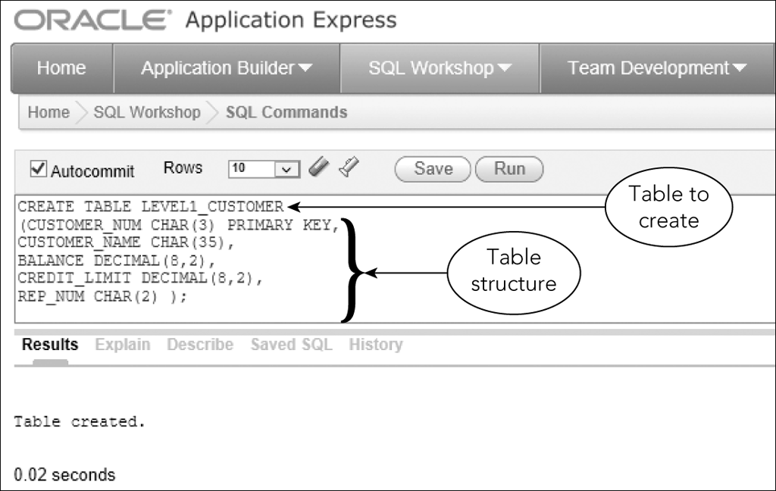
Creating a New Table from an Existing Table
Figure 6-1: Creating the LEVEL_1_CUSTOMER table

Slide 4
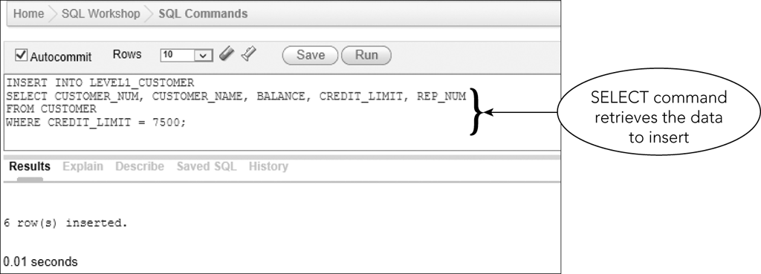
Creating a New Table from an Existing Table
Figure 6-2: INSERT command to add data to the LEVEL_1_CUSTOMER table

Slide 5
Changing Existing Data in a Table
Use UPDATE command to change rows for which a specific condition is true
Simple or compound condition
Command format
UPDATE (name of table to be updated)
SET (name of the column to be updated = new value)
Can include a calculation

Slide 6
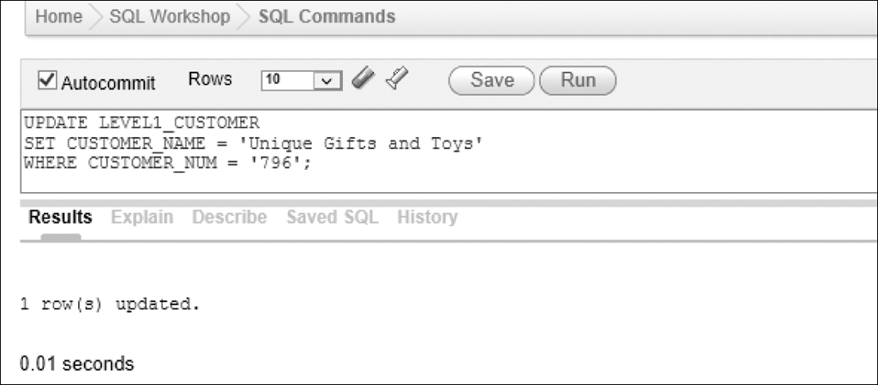
Changing Existing Data in a Table
Simple Condition
Figure 6-4: UPDATE command to change the name of customer 796

Slide 7
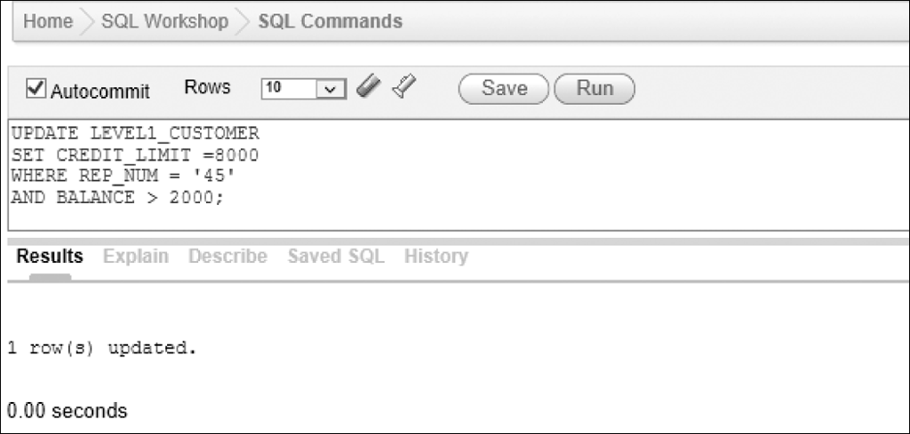
Changing Existing Data in a Table
Compound Condition
Figure 6-6: Using a compound condition in an update

Slide 8
Adding New Rows to an Existing Table
Use the INSERT command to add additional data to a table
Use the SELECT command to verify rows were added correctly

Slide 9
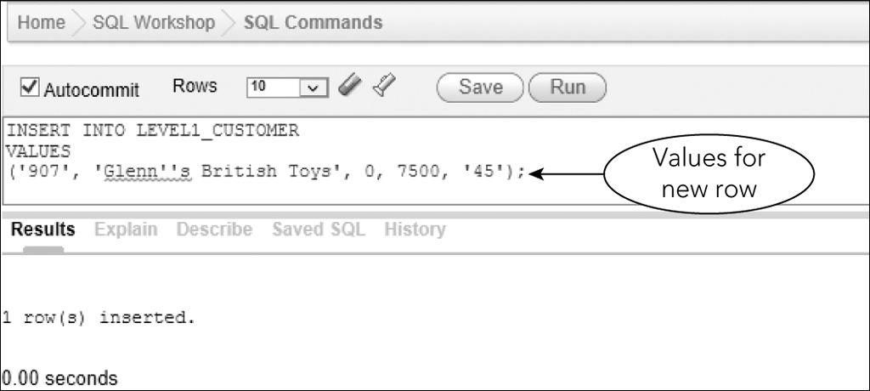
Adding New Rows to an Existing Table
Figure 6-8: Inserting a row

Slide 10
AUTOCOMMIT, COMMIT, and ROLLBACK
Autocommit is default transaction mode
Commits each action query as soon as the user executes each query
Clear check mark to turn off Autocommit in Oracle
Multi-user database applications require more control over transactions
Why do multi-user database applications require ability to rollback a transaction?
Airlines
Banking
Manufacturing

Slide 11
AUTOCOMMIT, COMMIT, and ROLLBACK
Updates to a table are only temporary
Can cancel during current work session
COMMIT command
Saves changes immediately during current session
ROLLBACK command
Reverses the changes made since last COMMIT command or in current work session

Slide 12
AUTOCOMMIT, COMMIT, and ROLLBACK
ROLLBACK command only reverses changes made to data
COMMIT command is permanent
Running ROLLBACK after COMMIT cannot reverse the update

Slide 13
Transactions
A transaction is a logical unit of work
A sequence of steps that accomplish a single task
Essential that the entire sequence be completed successfully
COMMIT and ROLLBACK commands support transactions

Slide 14
Transactions
Before starting updates for a transaction, COMMIT any previous updates
Complete the updates for the transaction
If it cannot be completed, use ROLLBACK
If all updates complete, use COMMIT again

Slide 15
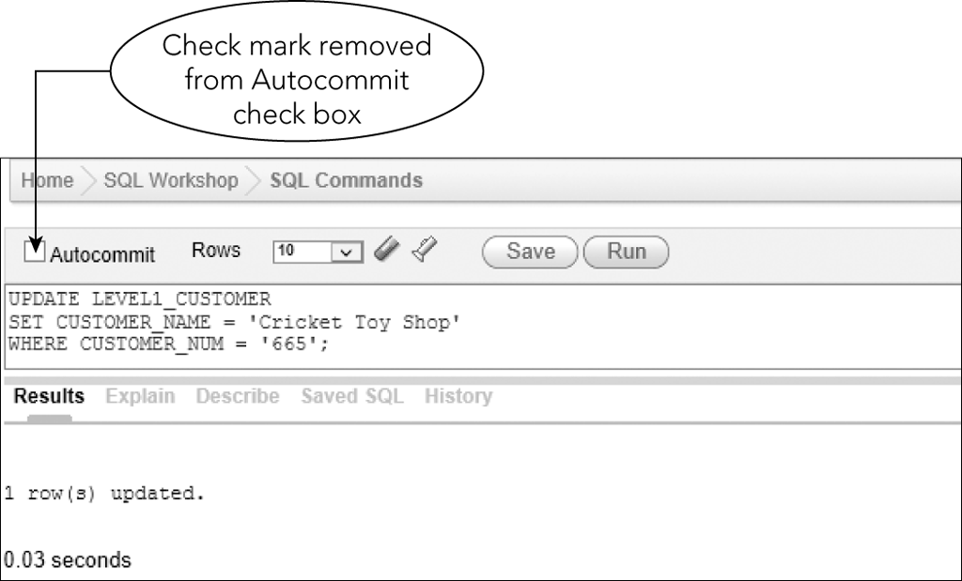
Changing and Deleting Existing Rows
Autocommit is turned off
Figure 6-10 Using an UPDATE command to change the name of customer 665

Slide 16
Changing and Deleting Existing Rows
Use DELETE command to delete data from database
Command format
DELETE (table from which the row(s) is to be deleted)
WHERE clause (with a condition to select the row(s) to delete)
All rows satisfying the condition will be deleted
If no condition, then all rows deleted!

Slide 17
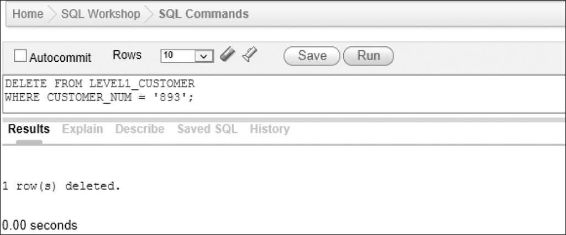
Changing and Deleting Existing Rows
Autocommit is turned off
Figure 6-11: Using DELETE command to delete customer 893

Slide 18
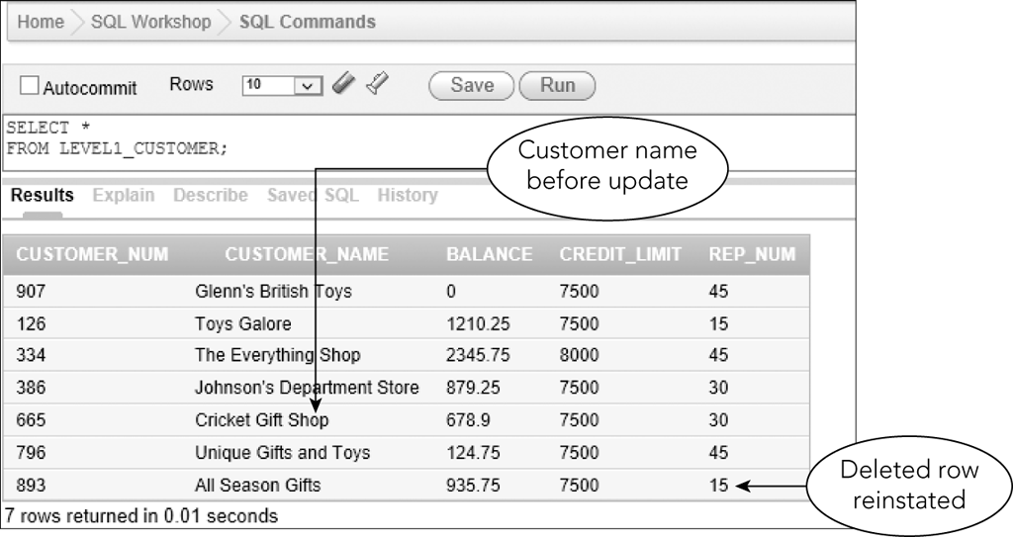
Executing a Rollback
ROLLBACK command
Figure 6-14: Data in the LEVEL_1_CUSTOMER table after executing a rollback

Slide 19
Changing a Value in a Column to Null
Command for changing value to null is the same as changing any other value
Affected column must be able to accept nulls
Use the value NULL as the replacement value

Slide 20
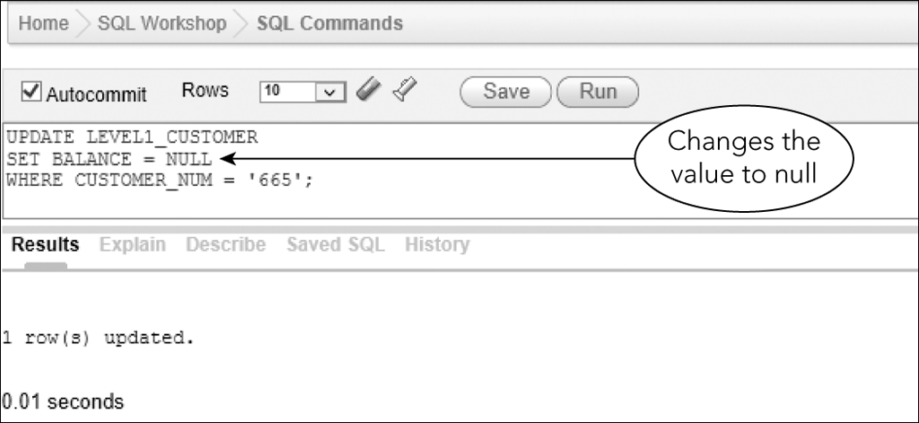
Changing a Value in a Column to Null
Figure 6-15: Changing a value in a column to null

Slide 21
Exercise
Use SQL to make the following changes to the CAT database (Figures 1-4 to 1-8 in the book). After each change execute an appropriate query to show that the change was made correctly.
Create a PADDLING table with the structure as shown in Figure 6-29.
Insert into the PADDLING the trip ID, trip name, state, distance, maximum group size and season from the TRIP table only for Paddling trips (9 records)
Insert a new trip into the PADDLING table: a summer trip to Lake Champlain in Vermont, max group size of 12, distance of 16.
Delete a trip from PADDLING table with ID 23.
The distance for the Pontook Reservoir Tour trip has been changed to an unknown number. Change the PADDLING table to reflect the change.

Slide 22
Changing a Table’s Structure
Add new tables
Delete tables no longer required
Add new columns to a table
Change physical characteristics of existing columns

Slide 23
Changing a Table’s Structure
ALTER TABLE command allows for changing a table’s structure
Use ADD clause to add a new column
ADD clause is followed by the name of column to be added, followed by its characteristics

Slide 24
Changing a Table’s Structure
Assign value to new column
Simplest approach is to assign NULL as the value
Or use an UPDATE command
Change all rows to most common value
Change individual rows

Slide 25
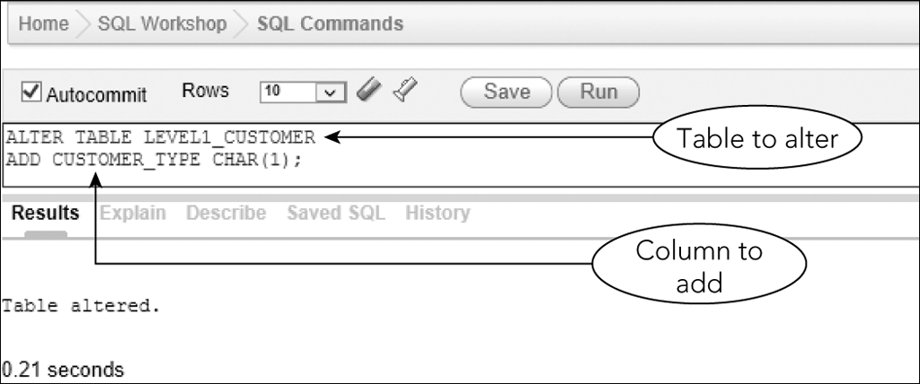
Changing a Table’s Structure
Figure 6-17: Adding a column to an existing table

Slide 26
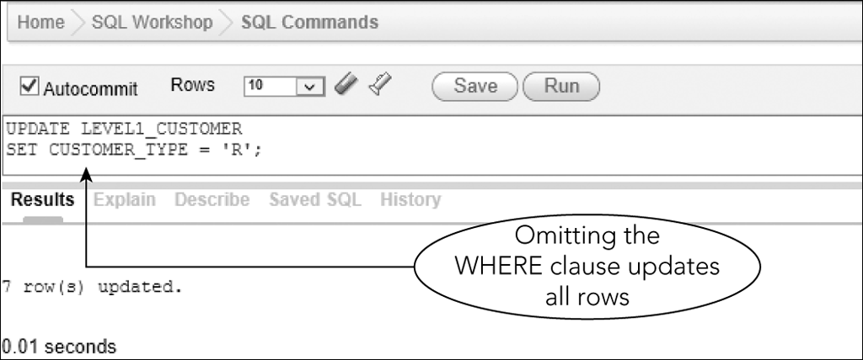
Changing a Table’s Structure
Figure 6-18: Make the same update for all rows

Slide 27
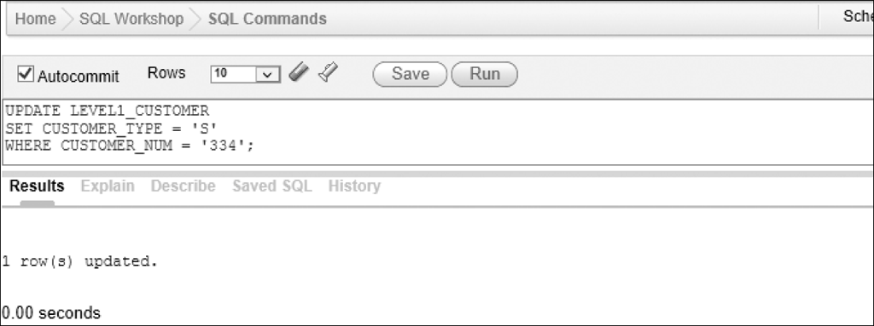
Changing a Table’s Structure
Figure 6-20: Updating customer 334 to customer type S

Slide 28
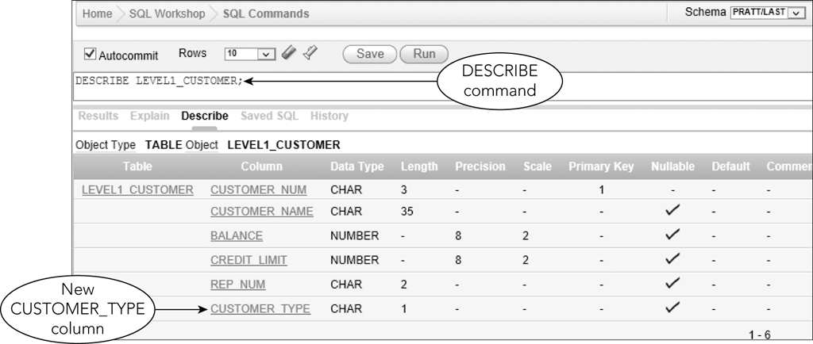
Changing a Table’s Structure
Figure 6-23: Structure of the LEVEL_1_CUSTOMER table

Slide 29
Changing a Table’s Structure
MODIFY clause of ALTER TABLE command changes characteristics of existing columns
Can use to change a column that currently rejects null values
Use NULL in place of NOT NULL
Can increase and decrease size of column

Slide 30
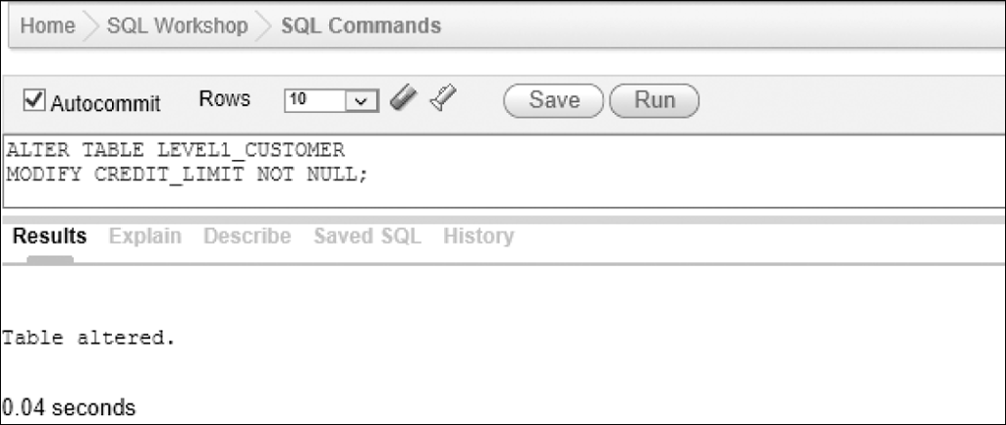
Changing a Table’s Structure
Figure 6-25: Changing the CREDIT_LIMIT column in the LEVEL_1_CUSTOMER table to reject null values

Slide 31
Making Complex Changes
Changes to table structure may be beyond the capabilities of SQL
Eliminate multiple columns
Change column order
Combine data from two tables to one
Potential solution: create a new table

Slide 32
Dropping a Table
Use DROP TABLE command to delete a table
Permanently removes table and all its data from database

Slide 33
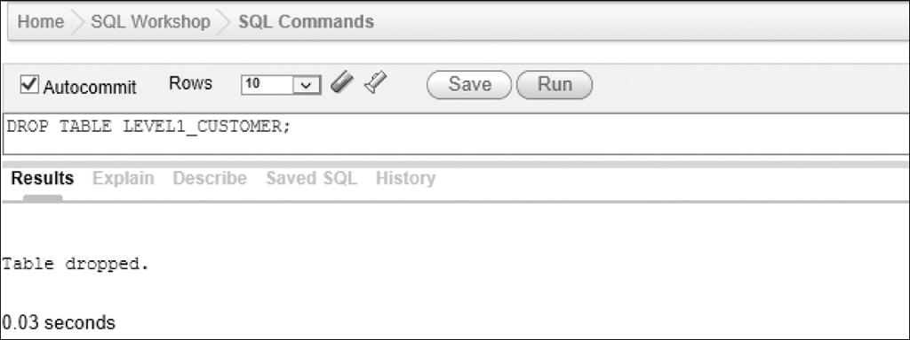
Dropping a Table
Figure 6-27: DROP TABLE command to delete the LEVEL_1_CUSTOMER table

Slide 34
Summary
Use CREATE TABLE command to make a new table from an existing table
INSERT statement containing a SELECT statement to insert data from existing table
Use UPDATE command to change data
Use INSERT command to add new rows
Use DELETE command to delete existing rows from a table

Slide 35
Summary
Use COMMIT command to make changes permanent
Use ROLLBACK command to reverse updates
Use SET clause in UPDATE command to change a value to null
Column name = NULL
Column must accept nulls

Slide 36
Summary
Use ALTER TABLE command with ADD clause to add a column to a table
Use ALTER TABLE command with MODIFY clause to change column characteristics
Use DROP TABLE command to delete a table and all its data

Slide 37
Exercise
Continue working on the the CAT database (Figures 1-4 to 1-8 in the book). After each change execute an appropriate query to show that the change was made correctly.
Add to the PADDLING table a new character column named DIFFICULTY_LEVEL that is three characters in length. Then set the default difficulty level value for all rows to the value “MOD”.
Change the DIFFICULTY_LEVEL column in the PADDLING table to HRD for the Lake Champlain Tour trip.
Change the length of the SEASON column in the PADDLING table to 25 characters.
Change the DIFFICULTY_LEVEL column in the PADDLING table to reject nulls.
Use the internet to research another data type that you can use in Oracle for character data, and then re-write the SQL command to create the PADDLING table using the other data type.
Change the PADDLING table structure to satisfy requirements for additional data of your choice.
Present your new table structure to the class.

Slide 38
Homework
Read the Oracle Data Types documentation at http://docs.oracle.com/cd/B28359_01/server.111/b28318/datatype.htm
If you were asked to design the database for a new social networking site (think of Facebook, Twitter, Instagram etc.), what tables would you need? What would be the columns, primary keys and relationships between the tables?
Create an entity relationship diagram
Write the SQL statements for tables
Write the SQL statements for sample data
Be prepared to present your design in class.

